Slide 1
Resource Management in Distributed Systems:
Distributed File Systems
VFSTR

Slide 2
Distributed File Systems
Definition:
Implement a common file system that can be shared by all autonomous computers in a distributed system
Goals:
Network transparency
High availability
Architectural options:
Fully distributed: files distributed to all sites
  Issues: performance, implementation complexity
Client-server Model:
  Fileserver: dedicated sites storing files perform storage and retrieval operations
  Client: rest of the sites use servers to access files
VFSTR

Slide 3
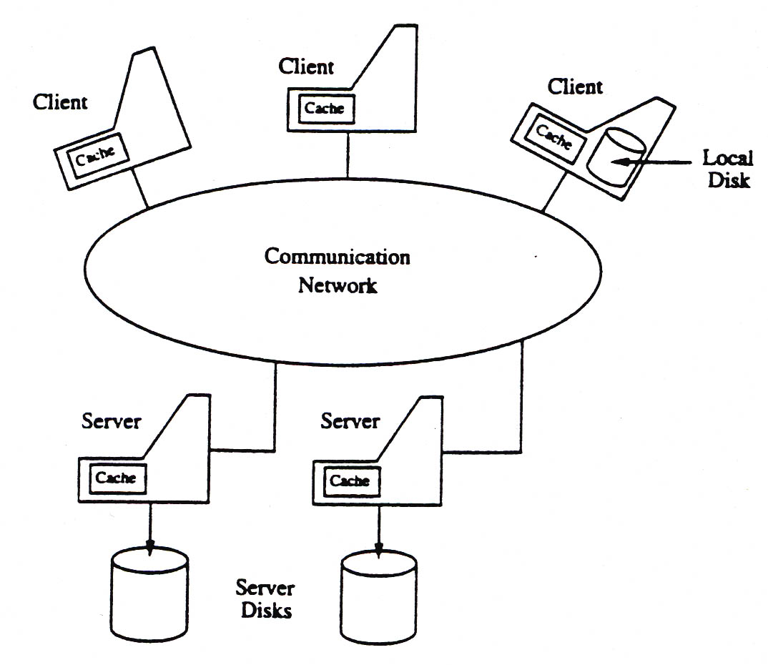
Distributed File Systems: Client-Server Architecture
VFSTR

Slide 4
Distributed File Systems Services
Services provided by the distributed file system:
  (1) Name Server: Provides mapping (name resolution) the names supplied by clients into objects (files and directories)
    Takes place when process attempts to access file or directory the first time.
  (2) Cache manager: Improves performance through file caching
    Caching at the client - When client references file at server:
      Copy of data brought from server to client machine
      Subsequent accesses done locally at the client
    Caching at the server:
      File saved in memory to reduce subsequent access time
  * Issue: different cached copies can become inconsistent. Cache managers (at server and clients) have to provide coordination.
VFSTR

Slide 5
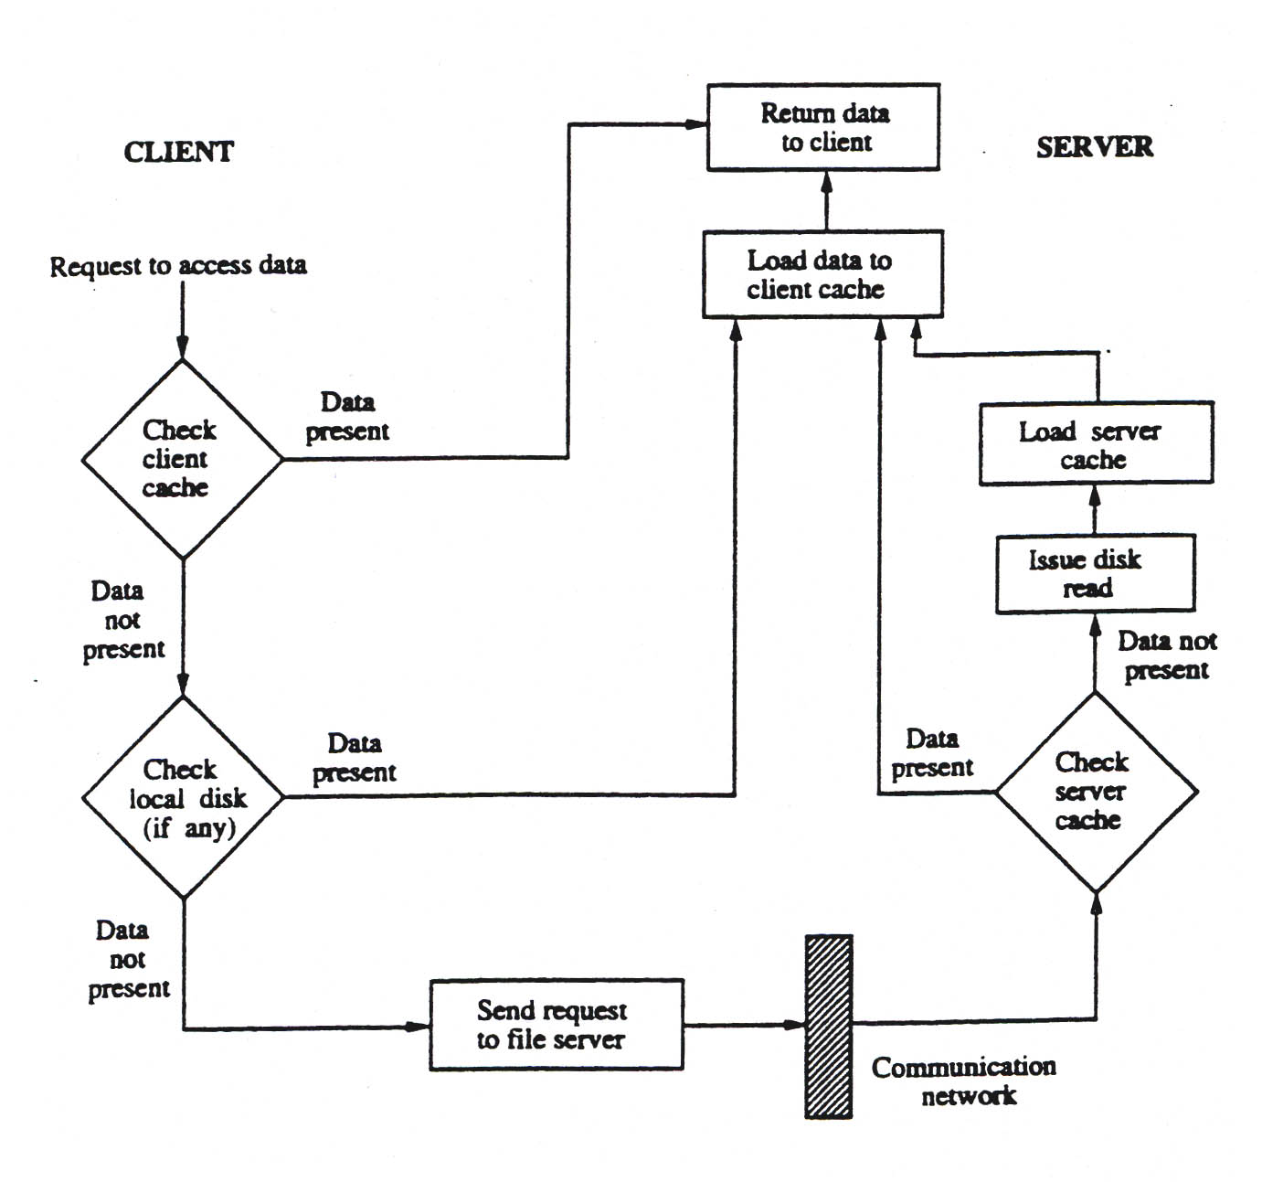
Typical Data Access in a Client/File Server Architecture
VFSTR

Slide 6
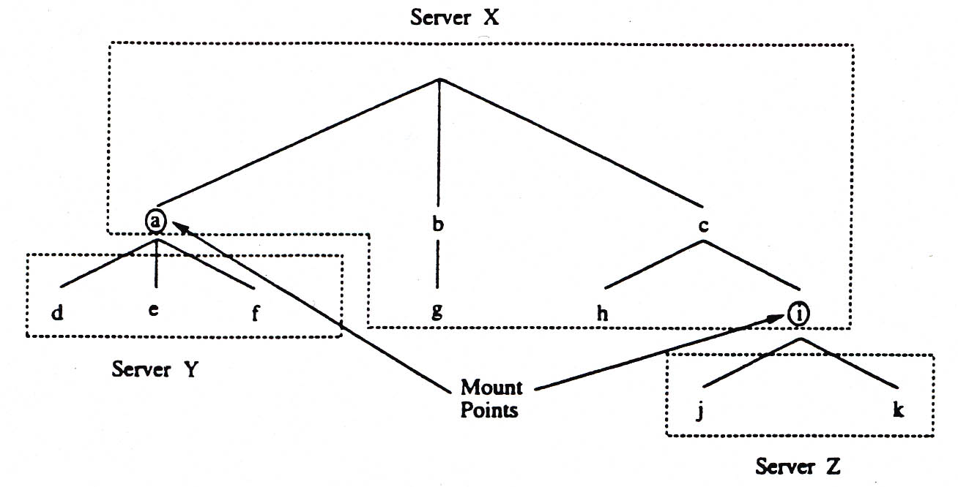
Mechanisms used in distributed file systems
Mounting
  The mount mechanism binds together several filename spaces (collection of files and directories) into a single hierarchically structured name space (Example: UNIX and its derivatives)
  A name space ‘A’ can be mounted (bounded) at an internal node (mount point) of a name space ‘B’
  Implementation: kernel maintains the mount table, mapping mount points to storage devices
VFSTR

Slide 7
Mechanisms used in distributed file systems (cont.)
(1) Mounting (cont.)
  Location of mount information
    a. Mount information maintained at clients
      Each client mounts every file system
      Different clients may not see the same filename space
      If files move to another server, every client needs to update its mount table
      Example: SUN NFS
    b. Mount information maintained at servers
      Every client see the same filename space
      If files move to another server, mount info at server only needs to change
      Example: Sprite File System
VFSTR

Slide 8
Mechanisms used in distributed file systems (cont.)
(2) Caching
  Improves file system performance by exploiting the locality of reference
  When client references a remote file, the file is cached in the main memory of the server (server cache) and at the client (client cache)
  When multiple clients modify shared (cached) data, cache consistency becomes a problem
  It is very difficult to implement a solution that guarantees consistency
(3) Hints
  Treat the cached data as hints, i.e. cached data may not be completely accurate
  Can be used by applications that can discover that the cached data is invalid and can recover
    Example:
      After the name of a file is mapped to an address, that address is stored as a hint in the cache
      If the address later fails, it is purged from the cache
      The name server is consulted to provide the actual location of the file and the cache is updated
VFSTR

Slide 9
Mechanism used in distributed file systems (cont.)
(4) Bulk data transfer
  Observations:
    Overhead introduced by protocols does not depend on the amount of data transferred in one transaction
    Most files are accessed in their entirety
  Common practice: when client requests one block of data, multiple consecutive blocks are transferred
(5) Encryption
  Encryption is needed to provide security in distributed systems
  Entities that need to communicate send request to authentication server
  Authentication server provides key for conversation
VFSTR

Slide 10
Design Issues
1. Naming and name resolution
  Terminology
    Name: each object in a file system (file, directory) has a unique name
    Name resolution: mapping a name to an object or multiple objects (replication)
    Name space: collection of names with or without same resolution mechanism
  Approaches to naming files in a distributed system
    (a) Concatenate name of host to names of files on that host
      Advantage: unique filenames, simple resolution
      Disadvantages:
        Conflicts with network transparency
        Moving file to another host requires changing its name and the applications using it
    (b) Mount remote directories onto local directories
      Requires that host of remote directory is known
      After mounting, files referenced location-transparent (I.e., file name does not reveal its location)
    (c) Have a single global directory
      All files belong to a single name space
      Limitation: having unique system wide filenames require a single computing facility or cooperating facilities
VFSTR

Slide 11
Design Issues (cont.)
1. Naming and Name Resolution (cont.)
  Contexts
    Solve the problem of system-wide unique names, by partitioning a name space into contexts (geographical, organizational, etc.)
    Name resolution is done within that context
    Interpretation may lead to another context
    File Name = Context + Name local to context
  Nameserver
    Process that maps file names to objects (files, directories)
    Implementation options
      Single name Server
        Simple implementation, reliability and performance issues
      Several Name Servers (on different hosts)
        Each server responsible for a domain
        Example:
        Client requests access to file ‘A/B/C’
        Local name server looks up a table (in kernel)
        Local name server points to a remote server for ‘/B/C’ mapping
VFSTR

Slide 12
Design Issues (Cont.)
2. Caching
  Caching at the client: Main memory vs. Disk
    Main memory: (+) Fast, (+) Works for diskless clients, (-) Expensive memory, (-) Complex Virtual Memory Management.
    Disk: (+) Large files, (+) Simpler Virtual Memory Management (-) Requires local disk.
  Cache consistency
    Server initiated
      Server informs cache managers when data in client caches is stale
      Client cache managers invalidate stale data or retrieve new data
      Disadvantage: extensive communication
    Client initiated
      Cache managers at the clients validate data with server before returning it to clients
      Disadvantage: extensive communication
    Prohibit file caching when concurrent-writing
      Several clients open a file, at least one of them for writing
      Server informs all clients to purge that cached file
    Lock files when concurrent-write sharing (at least one client opens for write)
VFSTR

Slide 13
Design Issues (Cont.)
3. Writing policy
  Question: once a client writes into a file (and the local cache), when should the modified cache be sent to the server?
  Options:
    Write-through: all writes at the clients, immediately transferred to the servers
      Advantage: reliability
      Disadvantage: performance, it does not take advantage of the cache
    Delayed writing: delay transfer to servers
      Advantages:
        Many writes take place (including intermediate results) before a transfer
        Some data may be deleted
      Disadvantage: reliability
    Delayed writing until file is closed at client
      For short open intervals, same as delayed writing
      For long intervals, reliability problems
VFSTR

Slide 14
Design Issues (Cont.)
4. Availability
  Issue: what is the level of availability of files in a distributed file system?
  Resolution: use replication to increase availability, i.e. many copies (replicas) of files are maintained at different sites/servers
  Replication issues:
    How to keep replicas consistent
    How to detect inconsistency among replicas
  Unit of replication
    File
    Group of files
      a) Volume: group of all files of a user or group or all files in a server
        Advantage: ease of implementation
        Disadvantage: wasteful, user may need only a subset replicated
      b) Primary pack vs. pack
        Primary pack:all files of a user
        Pack: subset of primary pack. Can receive a different degree of replication for each pack
VFSTR

Slide 15
Design Issues (Cont.)
5. Scalability
  Issue: can the design support a growing system?
  Example: server-initiated cache invalidation complexity and load grow with size of system. Possible solutions:
    Do not provide cache invalidation service for read-only files
    Provide design to allow users to share cached data
  Design file servers for scalability: threads, SMPs, clusters
6. Semantics
  Expected semantics: a read will return data stored by the latest write
  Possible options:
    All read and writes go through the server
      Disadvantage: communication overhead
    Use of lock mechanism
      Disadvantage: file not always available
VFSTR

Slide 16
Case Studies:
The Sun Network File System (NSF)
Developed by Sun Microsystems to provide a distributed file system independent of the hardware and operating system
Architecture
  Virtual File System (VFS):
  File system interface that allows NSF to support different file systems
  Requests for operation on remote files are routed by VFS to NFS
  Requests are sent to the VFS on the remote using
    The remote procedure call (RPC), and
    The external data representation (XDR)
  VFS on the remote server initiates files system operation locally
  Vnode (Virtual Node):
    There is a network-wide vnode for every object in the file system (file or directory)- equivalent of UNIX inode
    vnode has a mount table, allowing any node to be a mount node
VFSTR

Slide 17
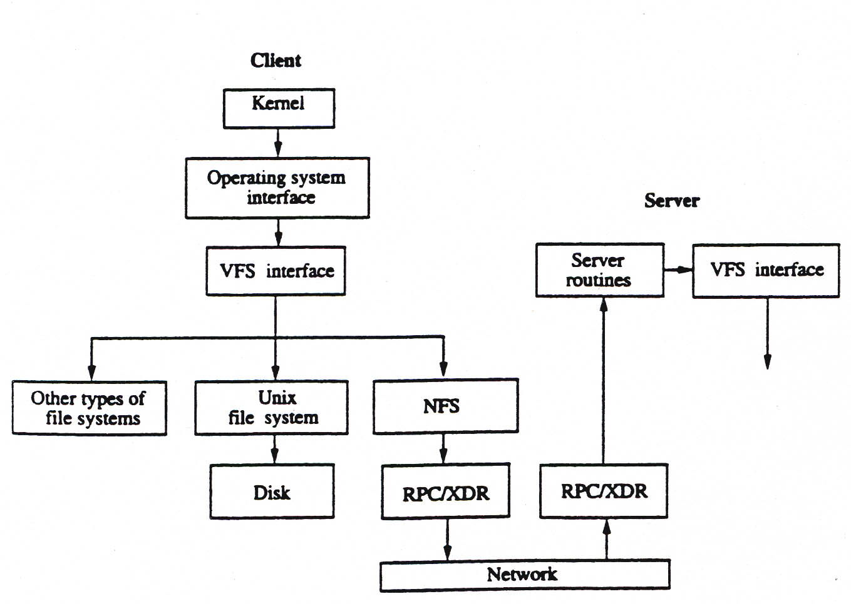
Case Studies: NFS Architecture
VFSTR

Slide 18
NFS (Cont.)
Naming and location:
  Workstations are designated as clients or file servers
  A client defines its own private file system by mounting a subdirectory of a remote file system on its local file system
  Each client maintains a table which maps the remote file directories to servers
  Mapping a filename to an object is done the first time a client references the field. Example:
  Filename: /A/B/C
    Assume ‘A’ corresponds to ‘vnode1’
    Look up on ‘vnode1/B’ returns ‘vnode2’ for ‘B’ where‘vnode2’ indicates that object is on server ‘X’
    Client asks server ‘X’ to lookup ‘vnode2/C’
    ‘file handle’ returned to client by server storing that file
    Client uses ‘file handle’ for all subsequent operation on that file
VFSTR

Slide 19
NFS (Cont.)
Caching:
  Caching done in main memory of clients
  Caching done for: file blocks, translation of filenames to vnodes, and attributes of files and directories
(1) Caching of file blocks
    Cached on demand with time stamp of the file (when last modified on the server)
    Entire file cached, if under certain size, with timestamp when last modified
    After certain age, blocks have to be validated with server
    Delayed writing policy: Modified blocks flushed to the server after certain delay
(2) Caching of filenames to vnodes for remote directory names
    Speeds up the lookup procedure
(3) Caching of file and directory attributes
    Updated when new attributes received from the server, discarded after certain time
Stateless Server
  Servers are stateless
    File access requests from clients contain all needed information (pointer position, etc)
    Servers have no record of past requests
  Simple recovery from crashes.
VFSTR

